Slide 1
Fall 2021 quarter Time_space_multiscale

Slide 2
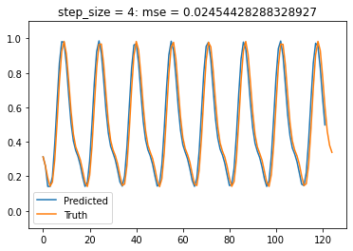
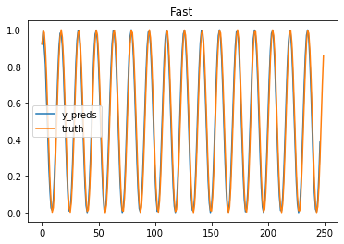
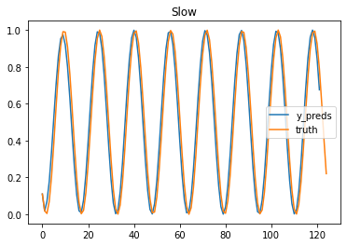
Started with toy2a. Small square is double frequency of others. Needed 1 refinement to get
First step on 1x1
Fast of 2x2. mse = 0.01559533
Slow of 2x2. mse =0.01345305

Slide 3
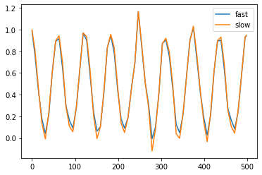
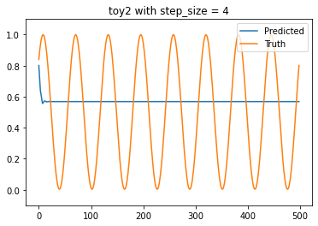
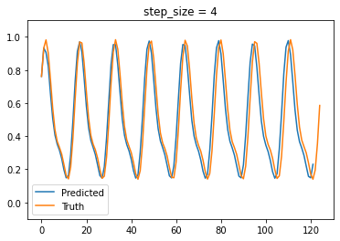
Needing additional inputs. When trying to fit toy2a, was having a few issues getting a good fitting
Then tried with 1 input, and got horrible prediction.
First tired with 4 inputs on 2x2, and got good prediction
When I used more inputs, x_t, x_t-1, x_t-2, we then got good prediction
Need more than 1 degree of freedom, and as f(x) gets more, complicated, need more degrees of freedom.
I explored this more in cos_explore.ipynb

Slide 4
Basic algorithm
Reduce data to 1d, (using average of all points)
Predict in time for various timesteps and find best timestep (using n (3) inputs, x_t, x_t-1, x_t-2)
Find error on 1 refinement in (on 2x2)
If error < threshold, mark resolved
Else, unresolve
For every unresolved square, repeat until all resolved
Predict in time with the 1 input
Find error on 2x2 of 1 more refinement
Find where resolved

Slide 5
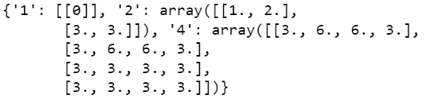
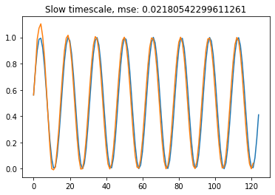
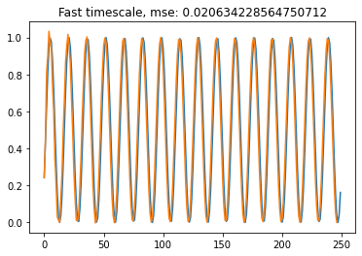
Shift the box slightly toy2b
Picking model 3 for where it is w0 (either on 2nd or 3rd iterations)
And model 6 where is it w1 on 3rd iteration.
This example required another resolution. Was able to find using 1 model on the small square, and the other model on the other square.
Had to put things together better.

Slide 6
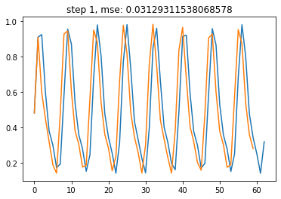
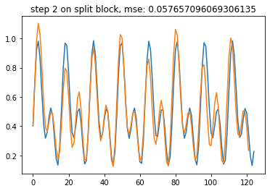
Found in step 2 and the final model for slow scale

Slide 7
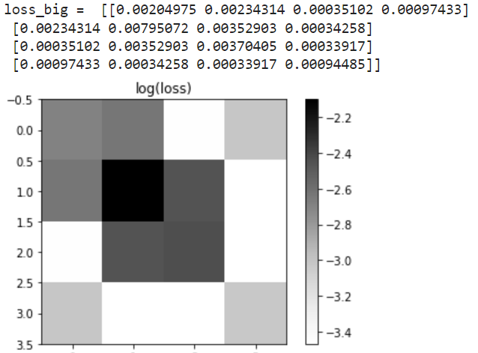
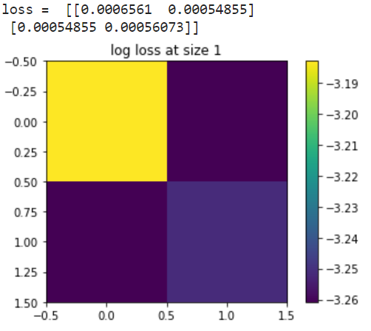
Next, tried with 2 gaussians. 1 double frequency of other, this time it’s a sum.
Error went up in second step??, still not very sure what’s happening there.

Slide 8
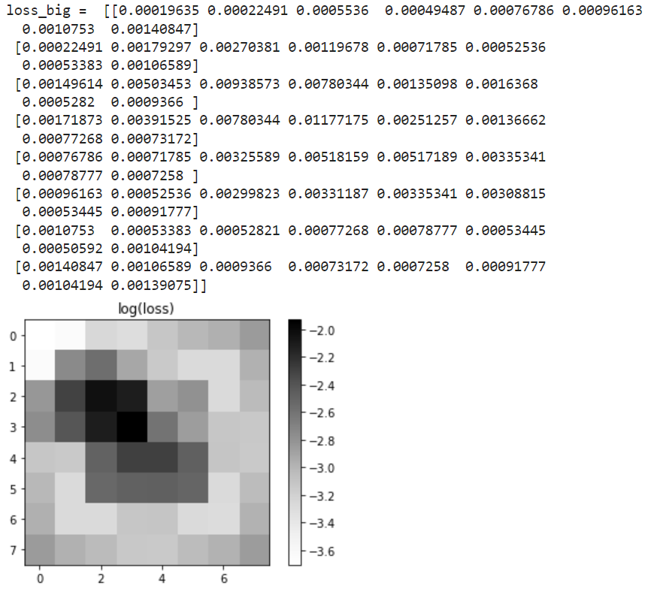
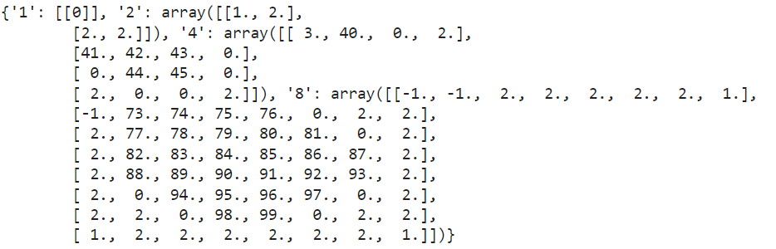
These are the models used on each step. There are a lot because many of them don’t get below the threshold value.
Also, noticing that the model specifically trained for that square doesn’t always produce the lowest error.
This is the error on the 8x8 as trained on the 4x4.

Slide 9
Making it so that it saved the model with the lowest validation error. This
I don’t seem to have a saved checkpoint of this for model toy3a, but it was using all mode 0 for the 2x2 and I think ended but having 3 total models for the 4x4. Seemed like a lot of models trained for that exact step didn’t make a lesser error. Idk if this was from bad training, need more timesteps as inputs, …

Slide 10
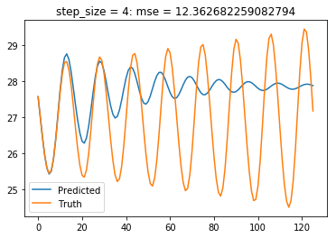
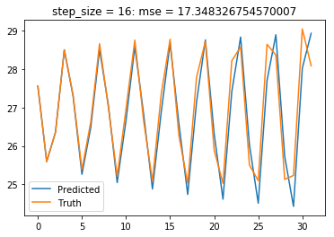
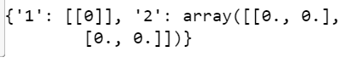
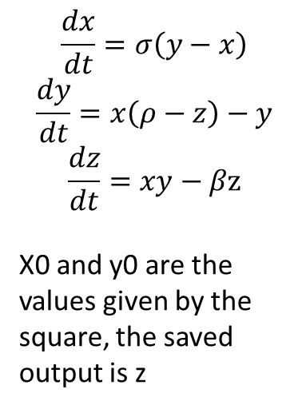
Trying variation of lorenz
$$\frac{dx}{dt}=σ\left(y−x\right)$$
$$\frac{dy}{dt}=x\left(ρ−z\right)−y$$
$$\frac{dz}{dt}=xy−βz$$
X0 and y0 are the values given by the square, the saved output is z
This model is just not fitting well like this
Keeping model zero for all of 2x2 because individually trained models have a higher error for each step

